Slide 1
Shining 3D Dental Scanner Introduction & Solutions
China's first OTC stock in 3D digitizing and 3D printing industry
Digital Dental Business Department
Copyright ©2015-2016 Shining3D. All rights reserved.

Slide 2
Agenda
Dental Department Introduction
2
AutoScan series products
3
Solutions

Slide 3
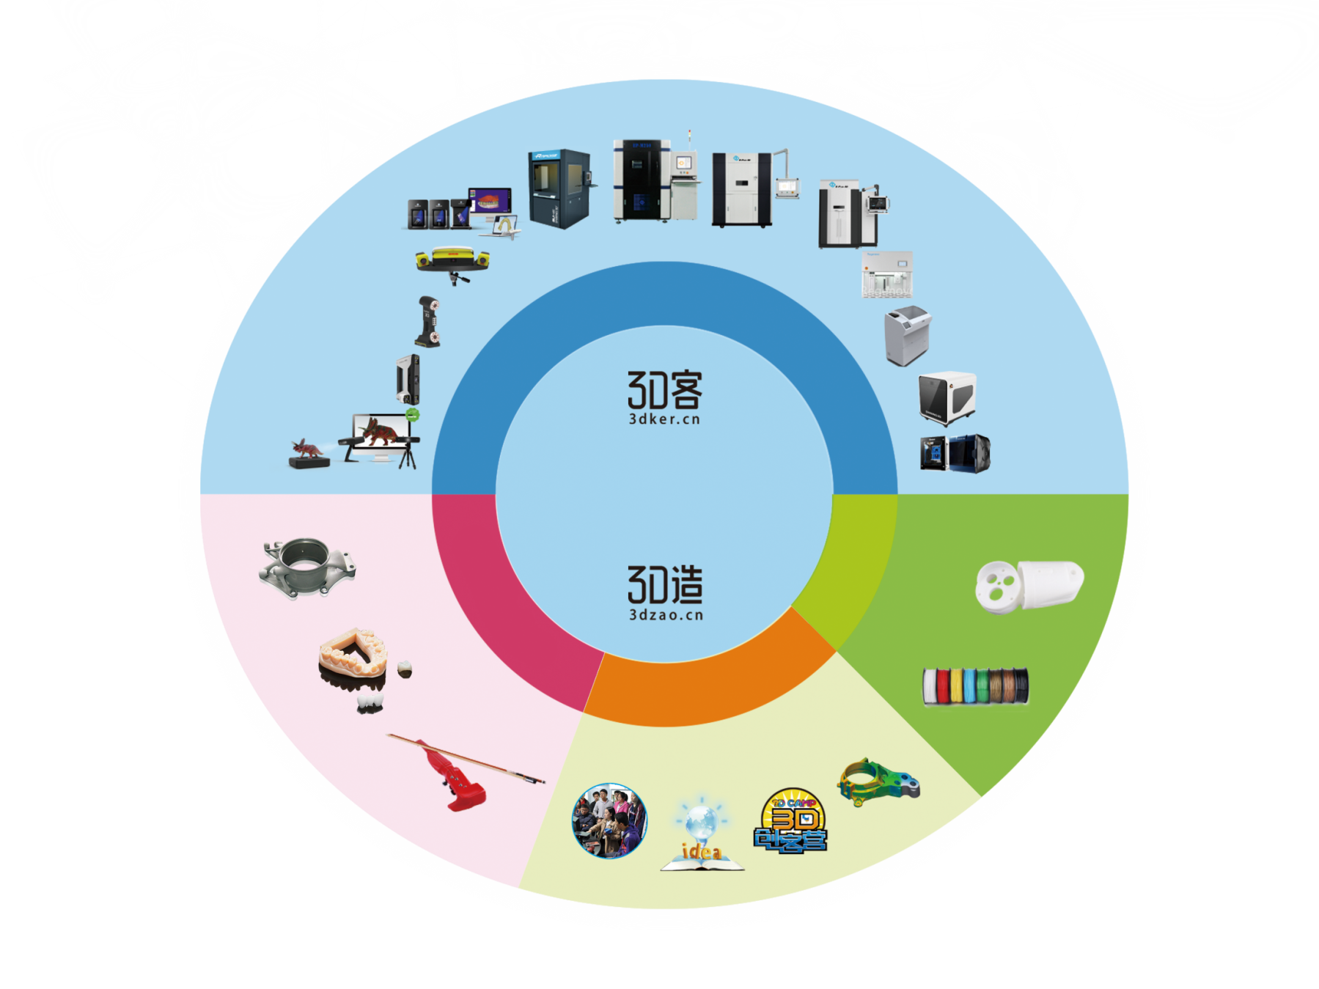
Initial Setup of 3D Printing Ecosystem
SLA 3D Printer
SLM 3D Printer
Dental Scanners
Sand 3D Printer
SLS 3D Printer
Scanners for Inspection
Regenovo Bio-Printer
3D scanning & 3D printing equipment
Laser Handheld 3D Scanner
Color 3D printer
Multi-functional Handheld 3D Scanner
3D Laser Machine
Desktop 3D Scanner
3D Printing
Ecosystem
Desktop 3D Printer
SLA material
Industry
3D Printing
Material
3D service
PLA
Medical
3D Data Service
3D Data
3D Teaching
3D Maker
Individual Creativity

Slide 4
Initial Setup of 3D Printing Ecosystem
Dental Scanners
3D scanning & 3D printing equipment
3D Printing
Ecosystem
3D Printing
Material
3D service
Medical
3D Data Service

Slide 5
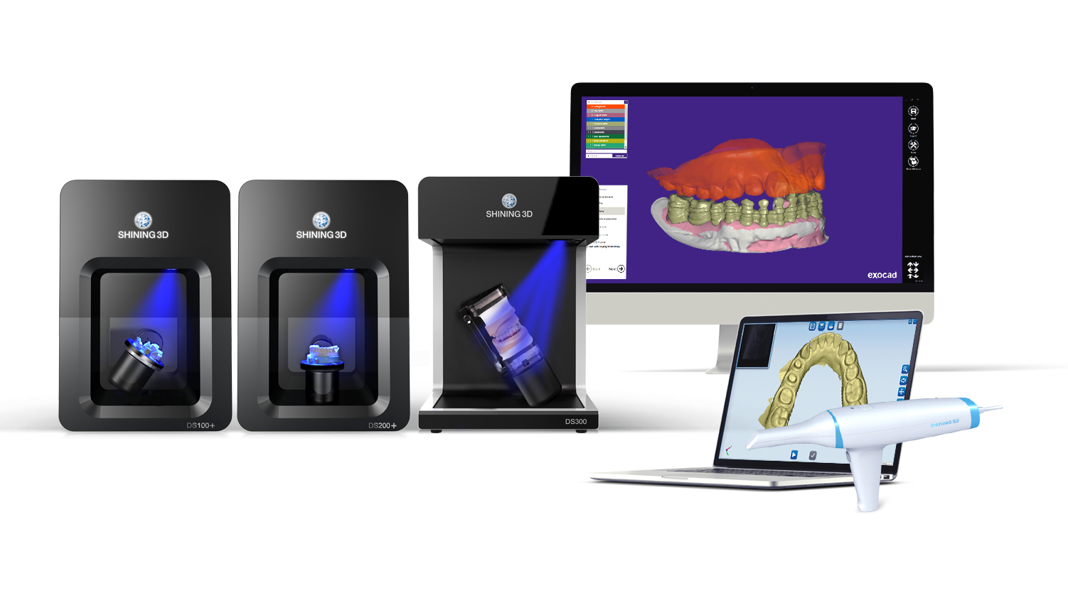
Dental Department
4

Slide 6
Dental Department
1000+ installations so far…
4

Slide 7
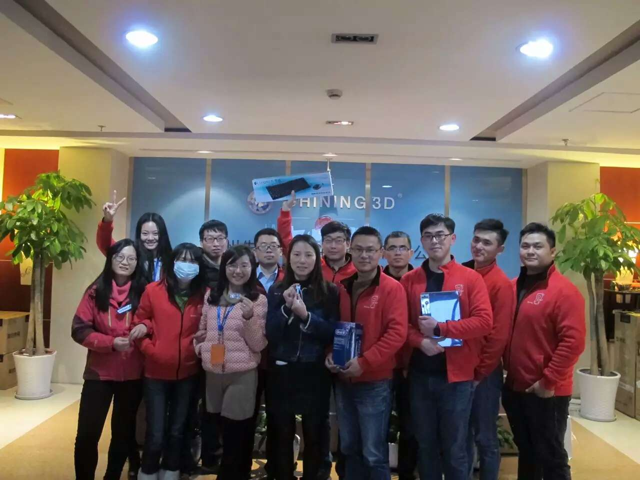
Dental Department
A Internal Skills Contest
First place goes Gevin
Trophy - electric toothbrush
4

Slide 8
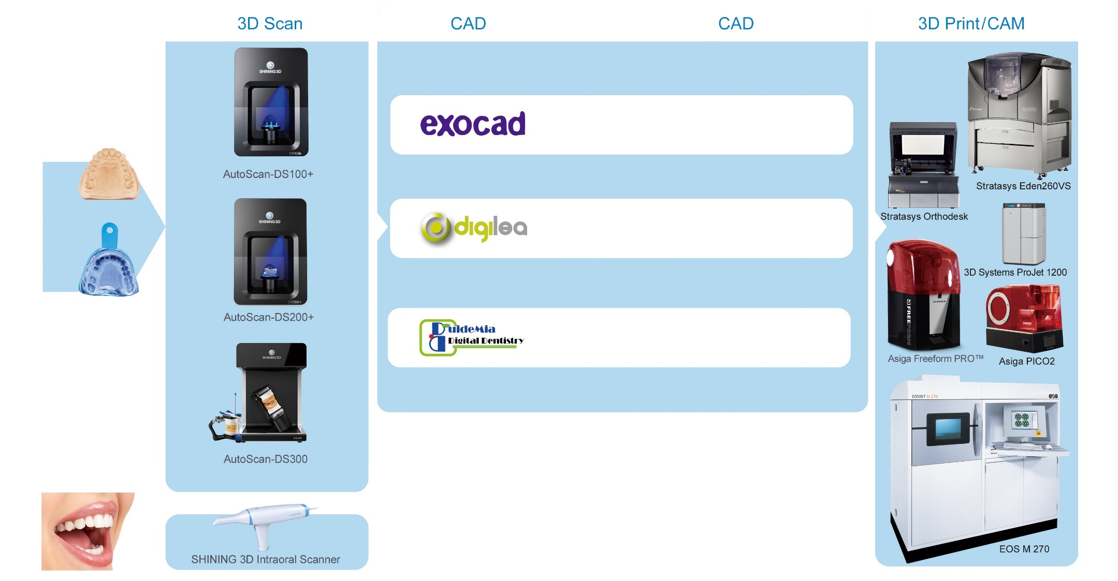
Dental Department
4

Slide 9
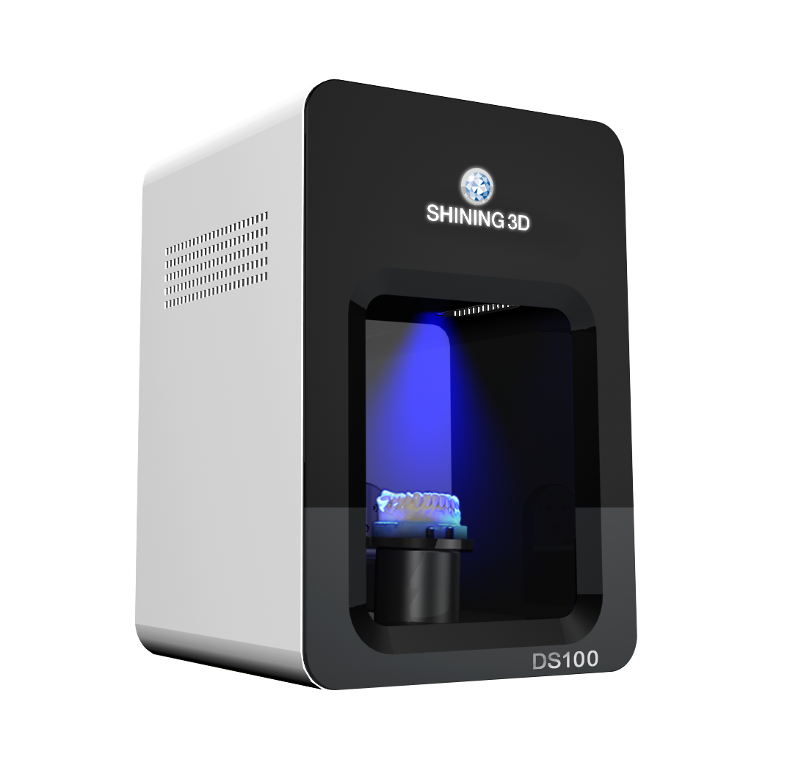
AutoScan DS100
Model | AutoScan-DS100
3D Scanning area | 100*100*75mm
3D scanning principle | Non-contact BLUE light scanning
Accuracy | < 15 micron
Scanning speed | Bite 18s; Upper /Lower Jaw 40s; 2-8 teeth 41s; Single tooth 40s; Impression 2mins
Resolution | 1.3MP
Weight | 20kg
Working temperature | 10℃~30℃
Power | DC24V
Output data format | STL
OS | Windows7/8/10, 64bits
4

Slide 10
AutoScan DS100
Entry level
Cost-effective
Open format output (exocad and 3shape)
Fast
Accurate
Easy to maintain
4

Slide 11
AutoScan DS100
Upgrade to DS100
New design, less weight
Blue light source
Speed and details improved
4

Slide 12
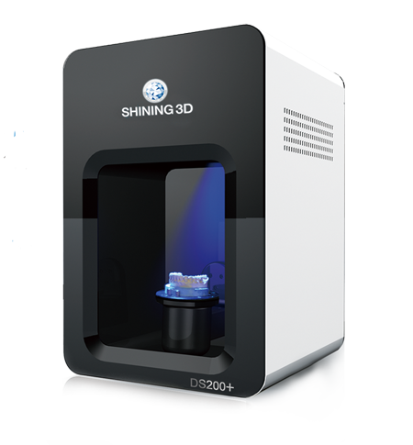
AutoScan DS200+
Unmatched scan speed
18sec / full arch
With color texture
4

Slide 13
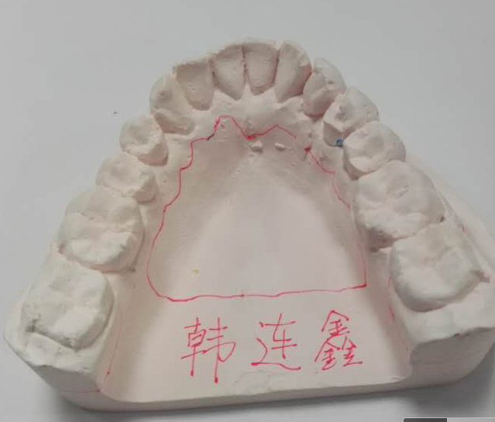
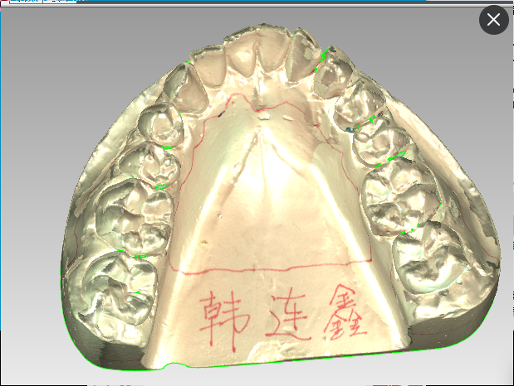
AutoScan DS200+
4

Slide 14
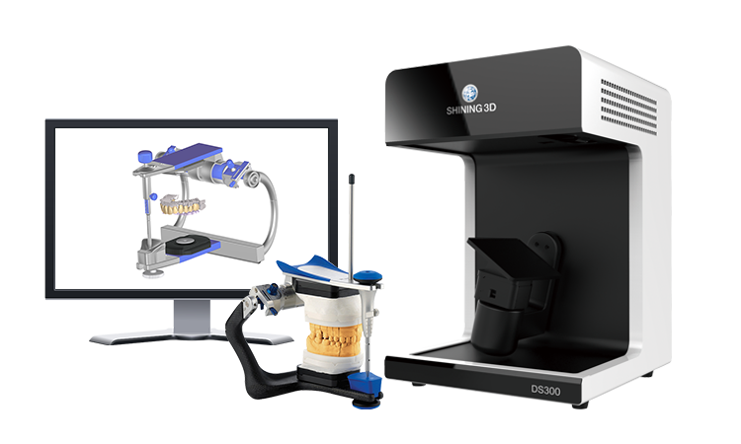
AutoScan DS300
Entirely NEW product
Aim to very advanced dental works
Support occlusion transferring
Capture more geometry surface details
(Edentulous jaw)
(Scan abutment)
4
Implant bar and all-on-4 or all-on-6 implant case
DS300 is born for implant cases !
Notes:
DS300 is a entirely new product from us. For this scanner, we don’t pursue speed any longer, our DS200+ is fast enough, we want to make something interesting, we were thinking what does our technician need beside speed.

Slide 15
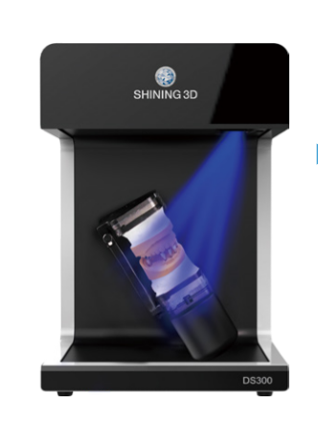
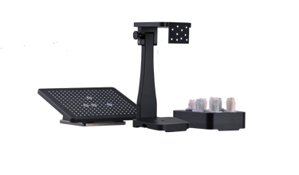
AutoScan DS300
Equipped with
Dual 3.0 MP cameras
New side-open design
Occlusion transfer tool (Included)
exocad modules: Implant, Articulator and Bar
4
Notes:
DS300 is a entirely new product from us. For this scanner, we don’t pursue speed any longer, our DS200+ is fast enough, we want to make something interesting, we were thinking what does our technician need beside speed.

Slide 16
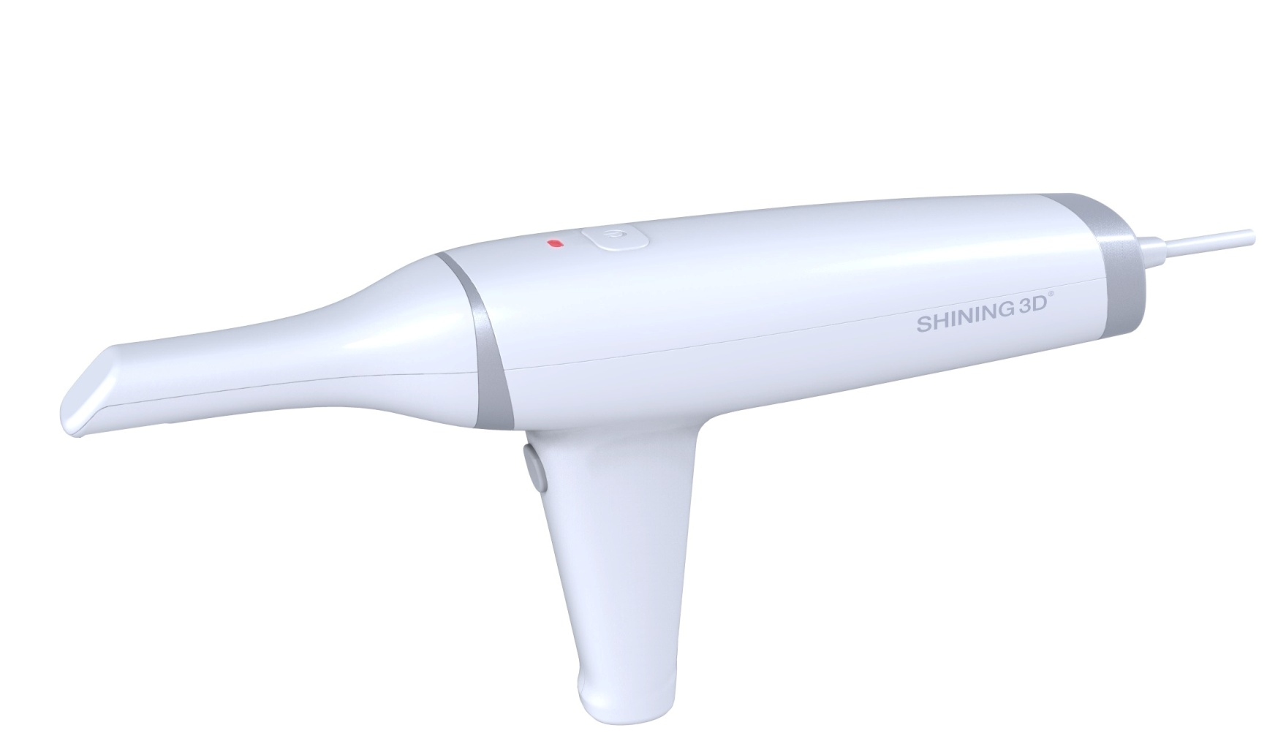
SHINING 3D Intraoral Scanner
Open
Accurate
Fast

Slide 17
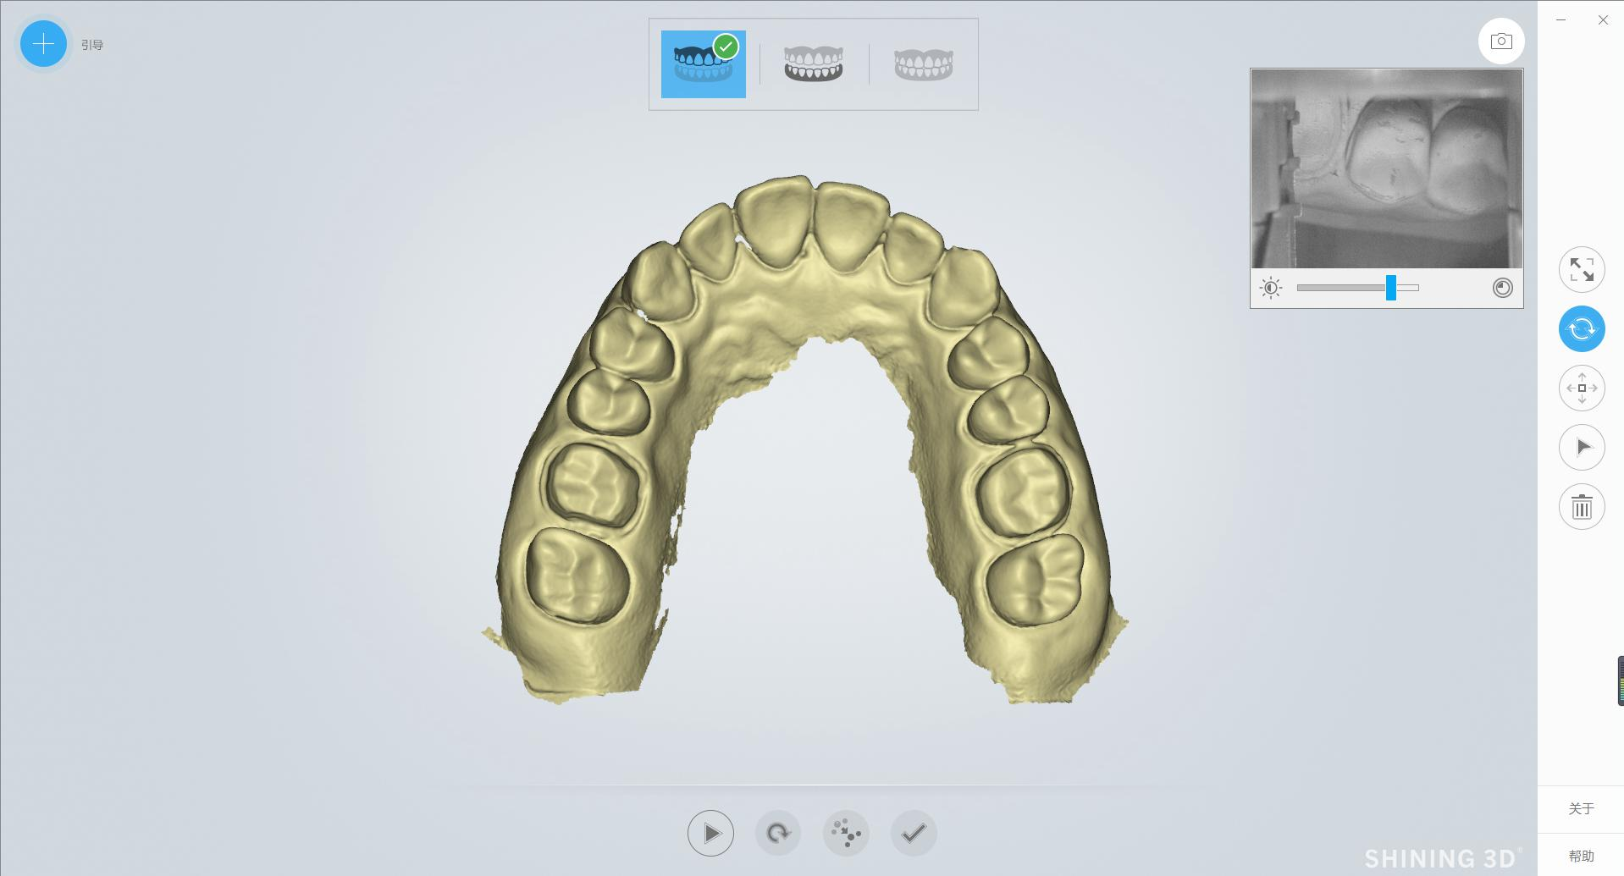
SHINING 3D Intraoral Scanner
4

Slide 18
Solution
Various solutions begin with scanner….
4

Slide 19
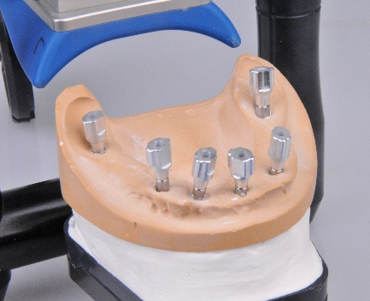
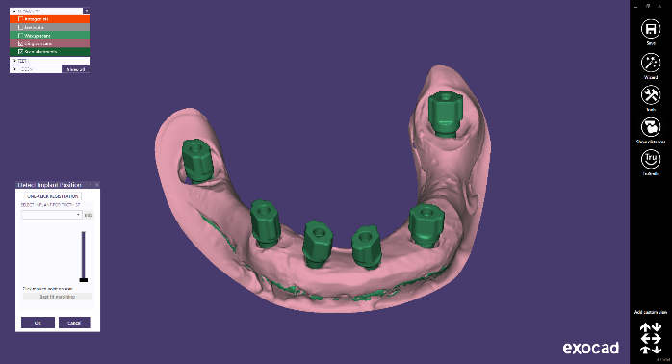
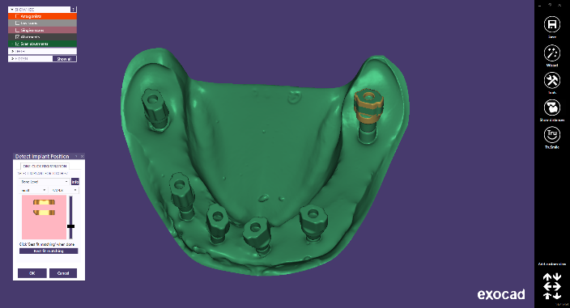
Solutions
#1 Implant screw retained bridge (Fully test by SHINING 3D)
Part 1
4

Slide 20
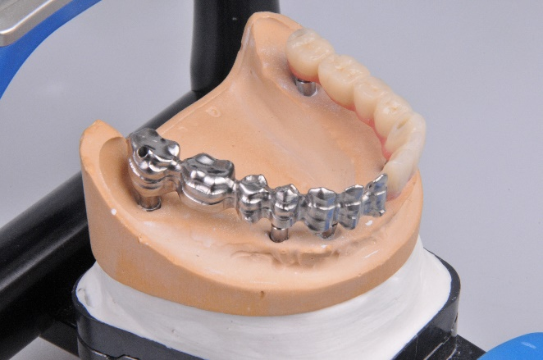
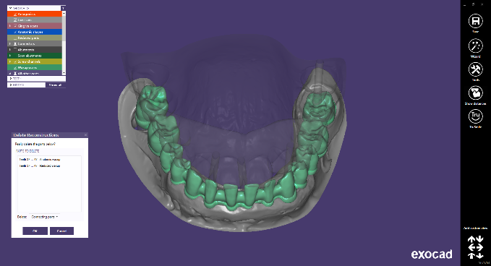
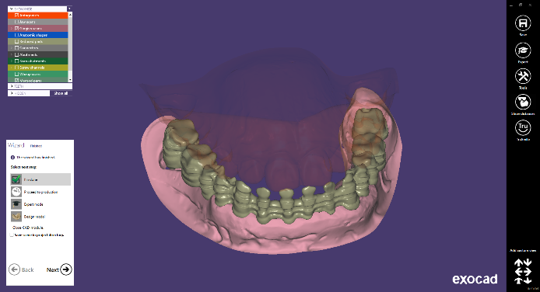
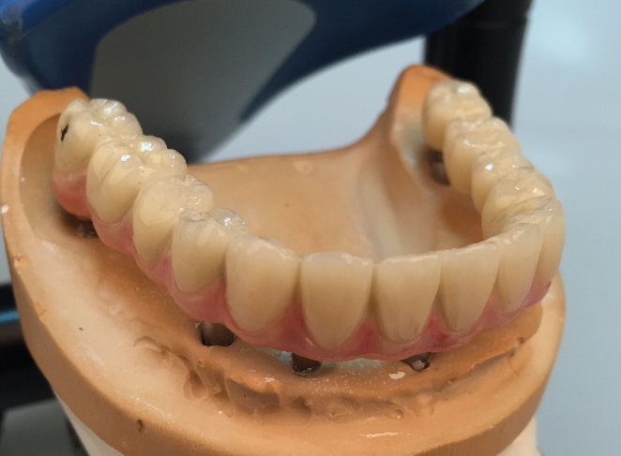
Solutions
#1 Implant screw retained bridge (Fully test by SHINING 3D)
Part 2
Semi-finished
4
Finished

Slide 21
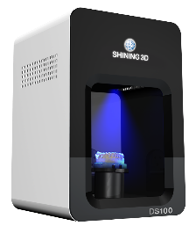
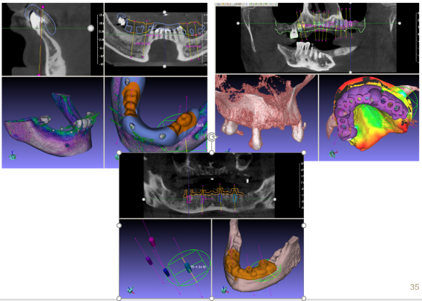
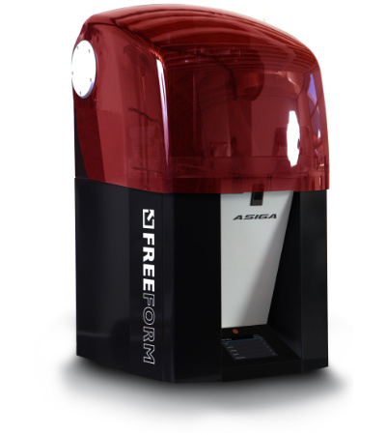
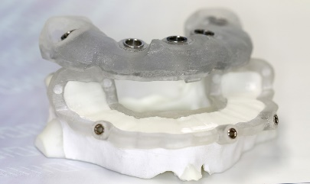
Solutions
#1 Implant planning and guide - in house manufacturing (Fully test by SHINING 3D)
CT/CBCT
4
GuideMia
ASIGA PRO2
Printed guide to be mounted in patient mouth

Slide 22
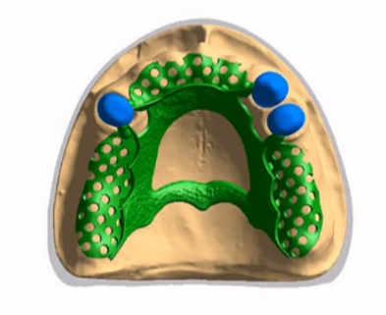
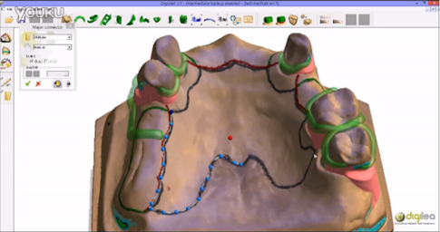
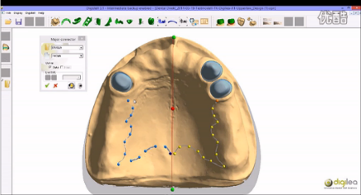
Solutions
#2 Removable partial denture (Fully test by SHINING 3D)
4
DS200+
Digistell
ASIGA PRO2
Printed framework to be casted with metal

Slide 23
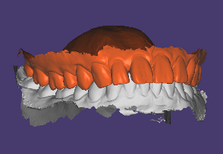
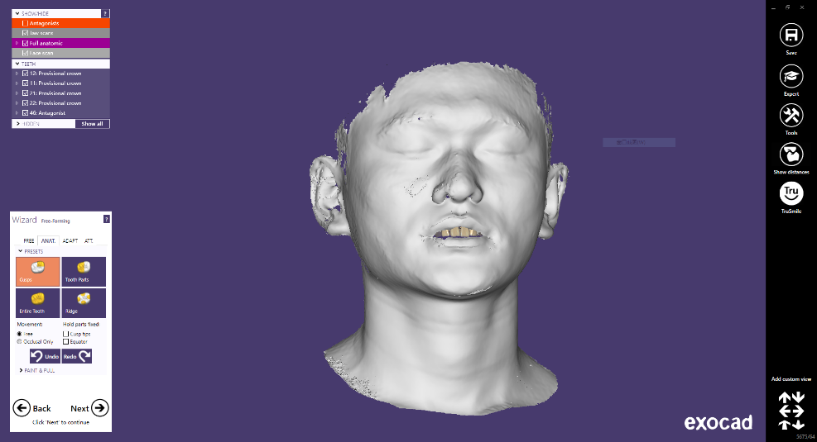
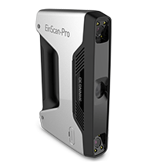
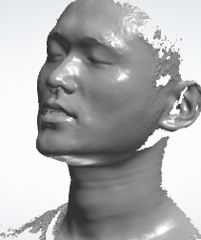
Solutions
#3 3D Smile Design (Initial test)
4
exocad

Slide 24
杭州先临三维科技股份有限公司
Tel：400-0799-666 Web：www.shining3d.com

